Slide 1
Fiscal Year 2024-25 Mid-Cycle Budget
Presented By: Lauren Sugayan, Assistant City Manager
City Council Meeting | May 29,2024

Slide 2
BACKGROUND
Fiscal Years 2023-2025 Council Goals
Staff attraction and retention
Financial sustainability
Vibrant and sustainable waterfront and marina
Strong downtown and commercial centers.

Slide 3
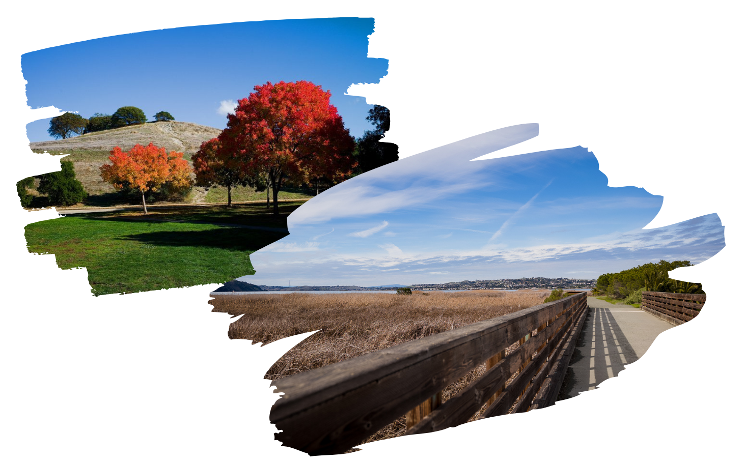
BACKGROUND
Fiscal Year 2023-24 Budget
$900,000 in budget cuts for FY 2023-24
Use of ARPA & Reserves to balance FY 2023-24 budget
$761,600 in unanticipated budget expenses by mid-year
Draw down on fund balance:
$614,000 (including Capital)
Additional draw down:
$198,636 (marina & MPNSEA MOU)

Slide 4
BACKGROUND
General Fund Unassigned Reserve Transfers
$2.5 million in transfers for projects since FY 2021-22
$1.7 million – Marina related repairs, projects, operating shortfall
$250,000 – Pool heaters and improvements
$243,524 – Hidden Lakes Park improvements
$218,500 – Drought Management Plan
$89,136 – Salary increases for MPNSEA member
$71,000 – Waterfront Field 5 improvements

Slide 5
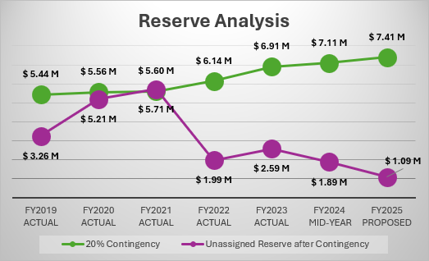
BACKGROUND

Slide 6
BACKGROUND
Fiscal Year 2024-25 Balanced Budget
$520,000 in budget cuts recommended for FY 2024-25
Core services maintained
20% Reserve Fund maintained
General fund challenges:
Main cost drivers are labor, insurance and pension costs
Higher interest income is not perpetual
Revenues not rising at the pace of costs
Minimal vacancies results in less labor savings
Depletion of one-time ARPA funds
Cautious use of General Fund Unassigned Reserves
20% of Operating Funds Remains

Slide 7
BACKGROUND
Fiscal Year 2024-25 Balanced Budget
Cost drivers
Insurance (across all funds) - $212,135 increase
Pension (across all funds)- $693,877 increase
Labor (General Fund) - $663,381 increase
Animal Control (police) - $62,801 increase
Recognition of new holidays (police) - $30,000 increase
20% of Operating Funds Remains

Slide 8
BACKGROUND
Fiscal Sustainability Planning –
Strict adherence to City Council goals
Implement a multi-year forecast and a strategic plan
Prioritize budgeting core services
Implement a process to manage competing priorities
Cautious use of General Fund Unassigned Reserves
Revisit fiscal policies
Preserve and grow revenue streams

Slide 9
BACKGROUND
Other cities facing significant budget challenges
San Ramon - $14.1 million deficit next FY
Benicia - $6.5 million deficit this FY, declared a fiscal emergency, and secured two voter initiatives in March
Suisun City - $1.9 million use of reserves; now below the 20% reserve fund policy

Slide 10
DISCUSSION - ARPA
Recommendation: Allocate remaining $172,731 to Council’s short term projects list:
Short Term, High Visibility Wins | Additional Requests
More communication to residents (with an emphasis on more social media and videos) Hold events in each sector of the community Community clean-ups “Coffee and Conversation” events Increase lights on the streets off of Main Street City banner program Plant trees with volunteers | Repairs to Mountain View Park basketball court Public Utility Art program Historical walking tour Public engagement for EPA grant

Slide 11
DISCUSSION – Revenue Adjustments
Revenue Category | Adjustment
Property Tax | Increase by $278,500
Sales & Use Tax | Decrease by $280,300
Measure X (0.50% rate) | Increase by $67,800
TOT | Increase by $50,000
Franchise Fees | Increase by $111,600
Fines and Forfeitures | Increase by $134,500
Intergovernmental Revenues | Increase by $186,800
Licenses and Permits | Decrease of $105,500
Charges for Services | Decrease of $262, 100
Use of Money & Property | Increase of $763,500
Other Revenue | Decrease of $270,000
Revenue - $37.5M | Total Increase of $896,000

Slide 12
DISCUSSION – Expense Adjustments
Revenue Category | Adjustments
General Government | Decrease of $55,926
Administrative Services | Decrease of $133,660
Finance | Increase of $8,446
Public Works | Decrease of $36,579
Police | Increase of $745,171
Community & Economic Development | Increase of $127,324
Non-Departmental | Increase of $9,202
Transfers Out | Decrease of $300,000
Total Revenue $37.4M | Total Increase of $100,000

Slide 13
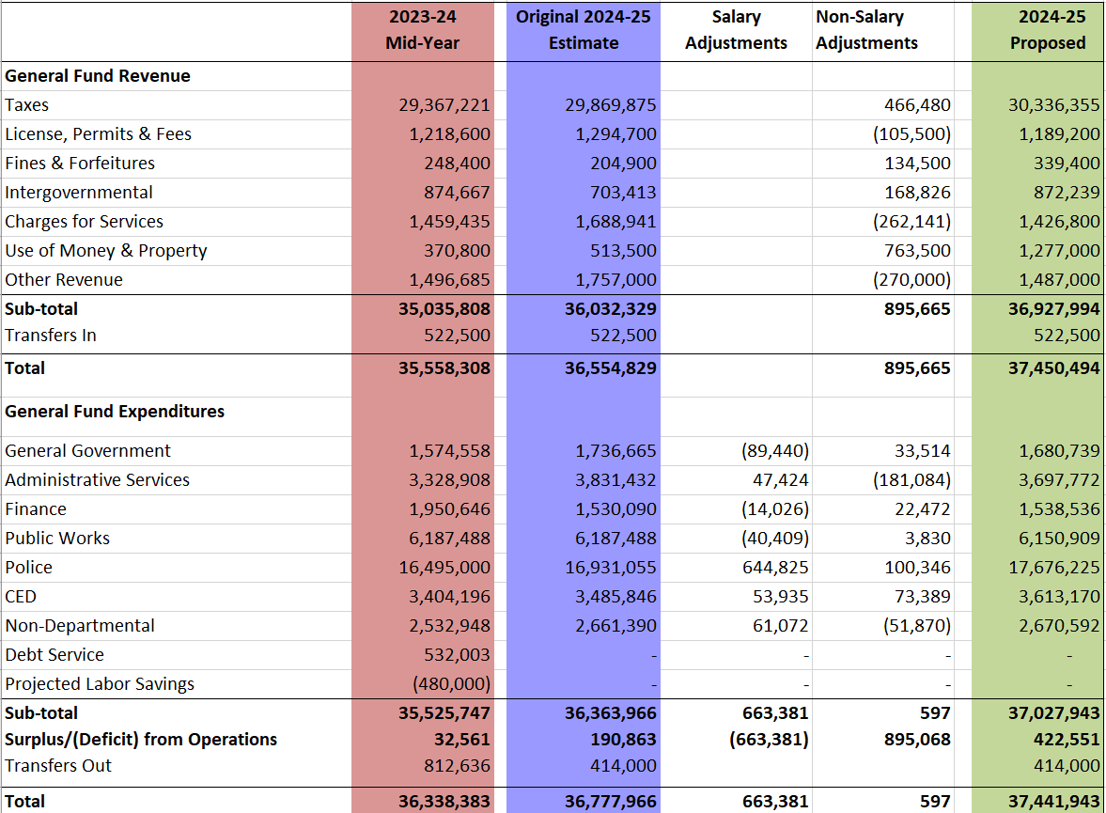
FY 24 Mid-Year
FY 25 Original
FY 25 Proposed

Slide 14
Discussion – Budget Objectives
Expanded City Hall Office Hours
New Dia de los Muertos Event
Revamped Fall pumpkin patch & festival
Revamped Holiday Frolic
Downtown power washing (1-2x)
Entryway and median enhancements
Sidewalk Repair Program
Project signage at Pine Meadows & Hidden Valley Pickleball Courts

Slide 15
Discussion – Other Funds
Other Funds | Adjustments
Water Fund | Increases of $300,000 in UAL pension costs, $50,000 in utility costs, and $155,000 in professional services costs needed to address new water quality regulations and anticipated repair and maintenance are projected
Parking Fund | No adjustments
Management Information System | Increases of approximately $120,000 reflecting the reallocation of staff from the Administration program to MIS; $100,000 in software licenses; $75,000 in non-capital purchases to keep pace with the computer replacement plan
Equipment Replacement | No adjustments
Marina Fund | No anticipated revenue from Almar; slight increase in rental income; anticipated decrease in professional services

Slide 16
Next Steps
Following input tonight, staff will return on June 26, 2024 with revisions and request adoption of the FY 2024-25 Budget.

