Slide 1
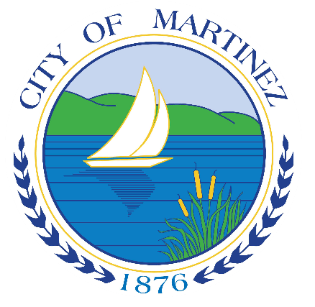
Alhambra Avenue Overlay District
Informational Presentation
November 2, 2023

Slide 2
Overview
Purpose
Background and Location
Description of AAO Provisions and Uses
Next Steps
Questions?

Slide 3
Purpose of AAO District
Revitalize and enliven the Alhambra Avenue corridor by encouraging multi-family housing development, particularly affordable housing, on underutilized properties.

Slide 4
Background
Draft 2023-2031 Housing Element Update (HEU) – adopted and submitted to State
State law requires the City to adopt new programs to expand opportunities and encourage new housing
Alhambra Avenue Overlay (AAO) District is one of several programs to implement the HEU
AAO must be adopted by January 31, 2024

Slide 5
AAO District Map

Slide 6
Description of AAO Provisions and Uses
Density: 21.5 – 43 housing units per acre
Review Process: “By right” stream-lined development processing
Objective Standards: Development standards consistent with the R-1.5 zoning district and applicable Specific Plan
Parking: 1 parking stall per unit plus truck loading requirements

Slide 7
Affordability Terms
Affordability:
20 percent very low-income or low-income units, or
30 percent moderate income units
Deed Restriction:
55 years for rental units
45 years for owner-occupied units

Slide 8
“By Right” Streamlined Processing
“By Right” Streamlined Processing Benefits:
No discretionary City review process
No CEQA review (California Environmental Quality Act)
Development Project qualifies if it complies with:
Affordability Standards
Density Standards
Objective Development Standards (R-1.5 zoning standards, etc.)

Slide 9
Next Steps
Planning Commission Public Hearing – November 14, 2023, 7:00 p.m.
Planning Commission will make a recommendation to City Council on adoption of all Housing Element Update changes and implementation programs, including adoption of the AAO District.
Public Comments welcome.
City Council Public Hearing – December 6, 2023, 7:00 pm
City Council will make a determination on adoption of all Housing Element Update changes and implementation programs, including adoption of the AAO District.
Public Comments welcome.

Slide 10
Questions
We are happy to answer your questions now, or you can contact us at:
Victoria Walker, Consultant: vwalker@solutions-mrg.com
Michael P. Cass, Planning Manager: mcass@cityofmartinez.org

